Slide 1

An analysis of online news article popularity using linear regression
Darian Gurrola

Slide 2



About me
Data Analytics Graduate Student at Western Governors University
Applied Data Fellow at the University of Chicago
Data analytics contractor at Cook County Health

Slide 3

Business problem and hypothesis
Digital media platforms rely on high readership for advertising revenue
To what extent do the number of words in an article title, the number of words in an article, the number of links in an article, the number of keywords in the article’s metadata, and the text sentiment polarity of an article influence the number of shares an online news article receives?
Null Hypothesis: The variables "n_tokens_title", "n_tokens_content", "num_hrefs", "num_keywords", and "global_sentiment_polarity" do not have a statistically significant effect on the dependent variable, "shares".

Slide 4
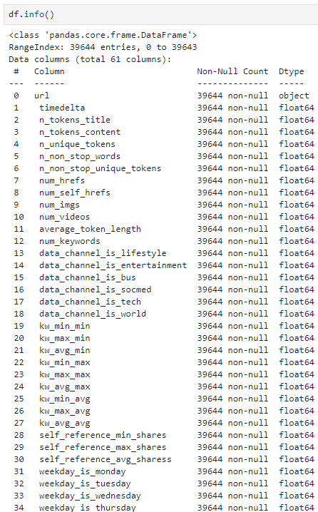
Data analysis summary
Data Acquisition
Online News Popularity Dataset from UC Irvine Machine Learning Repository
Contains 58 features and 39,727 observations
Data Exploration
Identify unnecessary features
Univariate and Bivariate Visualizations
Data Cleaning
TTreat null or missing values
Thousands of outliers retained

Slide 5
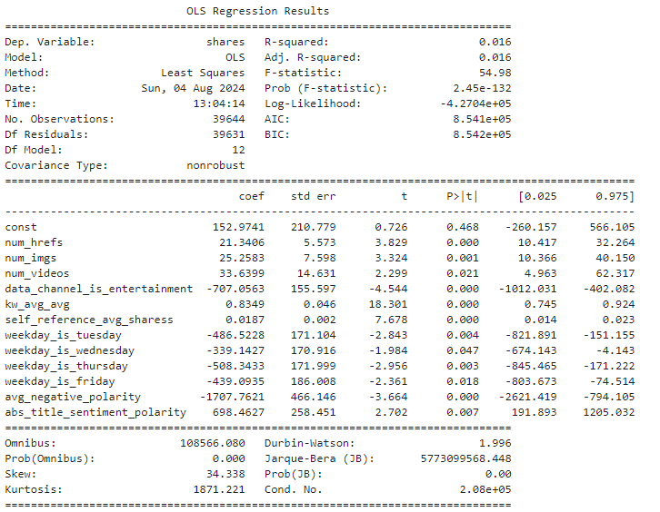
Data analysis summary
Built initial model using all relevant variables identified
Backwards Stepwise Elimination
Treat multicollinearity by removing variables with VIF > 10
Retain statistically significant variables with p-value < 0.05
Final Model
Contained 12 statistically significant variables
Adjusted R-Squared: 0.016
Residual Standard Error: 11,533.10
P-value of F-statistic:

Slide 6
Outline of findings
Unable to reject the null hypothesis
Only “num_hrefs” was statistically significant
Based on p-value of F-statistic, the model itself statistically significant
Adjusted R-squared value of 0.016 indicates a poor fit
Relatively High Residual Standard Error of 11,533.10
Overall, the model has very little predictive value

Slide 7
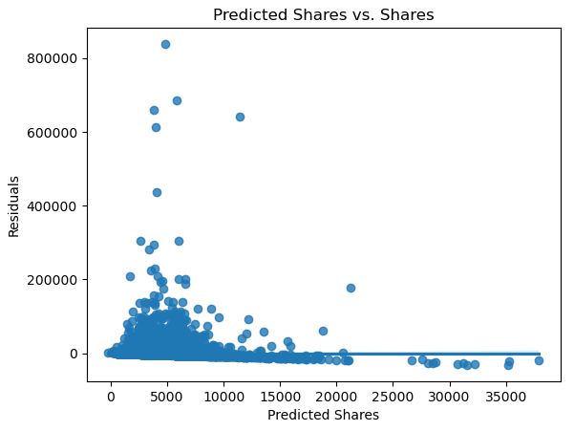
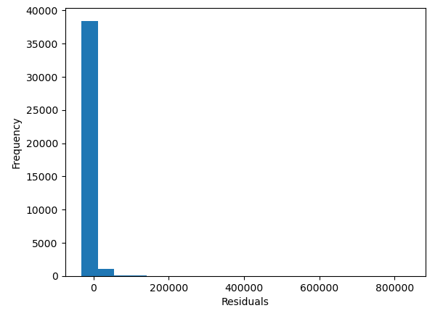
Limitations of tools and techniques
Linear regression models are sensitive to outliers
Features lacked linear relationship with “shares”
Residual plot did not demonstrate independence of residuals
Residuals did not demonstrate a normal distribution

Slide 8
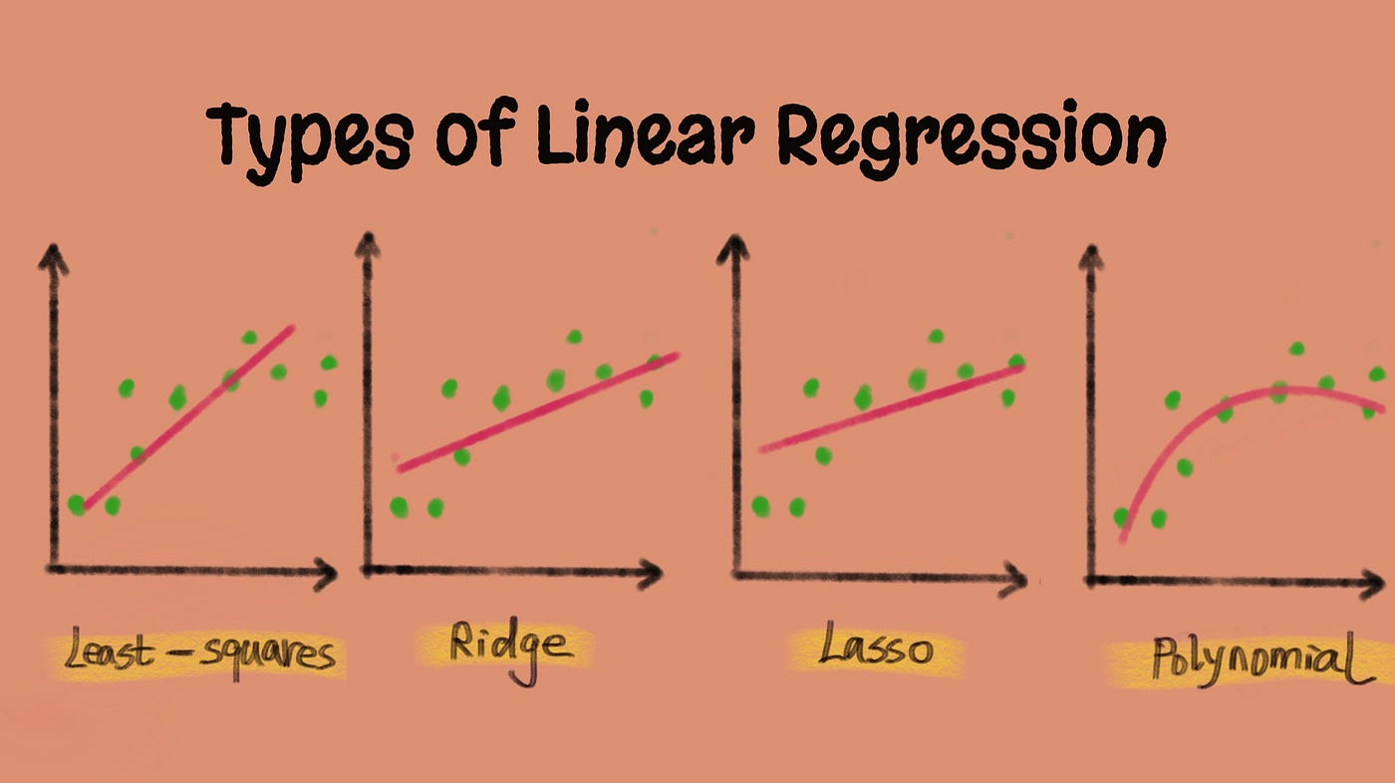
Proposed actions
Perform a new analysis using a different approach
Option 1: Impute or remove outliers in the data and attempt linear regression again
May help meet the assumptions of linear regression
Could reduce sample size or introduce bias
Option 2: Use a different model such as lasso or ridge regression
Works better for non-linear data
Would avoid linear regression assumptions altogether

Slide 9
Expected benefits
Identification of most predictive variables through backwards stepwise elimination
Successfully removed all variables with VIF > 10 and p < 0.05
Final model contained 12 out of 32 variables
Creation of a statistically significant model
p-value of F-Statistic was below 0.05
Adjusted R-Squared of 0.5
Model only resulted in value of 0.016

Slide 10
Thank You

